Slide 1
Exploring Core Machine Learning Concepts: Regression and Classification
Yunze Wu
ITAI 1371 – Machine Learning Fundamentals

Slide 2
Conceptual Overview
Supervised learning trains on labeled data to predict outcomes, while unsupervised learning finds patterns without labels. Overfitting occurs when a model memorizes training data instead of learning general patterns; it can be reduced through regularization or cross-validation. Distance metrics such as Euclidean and Manhattan measure similarity between samples and are essential for clustering and KNN algorithms.

Slide 3
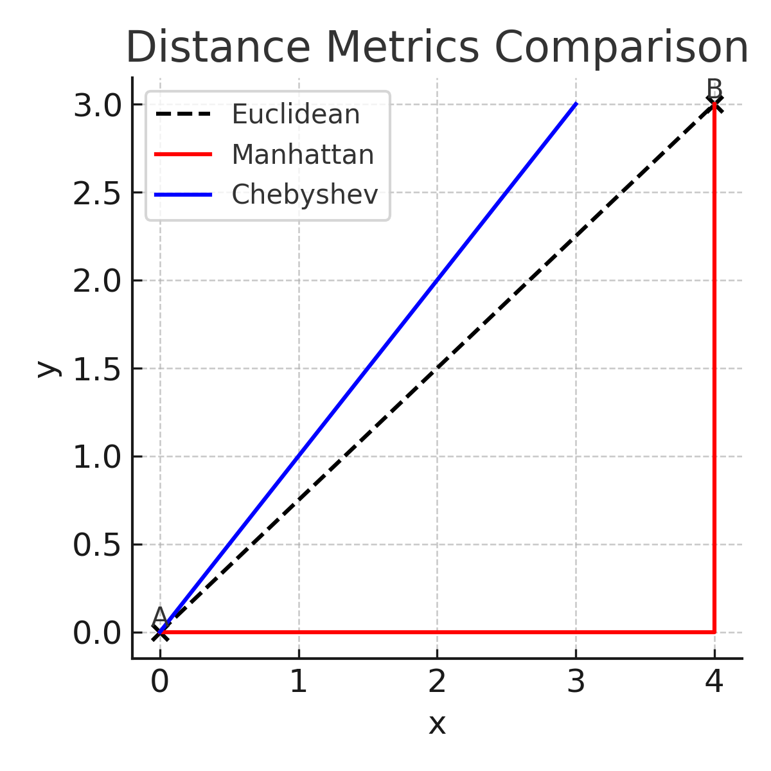
Analytical Insights
The Euclidean distance measures straight-line similarity, Manhattan distance measures grid-based path length, and Chebyshev distance focuses on the maximum coordinate difference. K-Fold validation showed consistent performance with a mean accuracy of 0.82 and standard deviation of 0.0158, indicating model stability. L2 regularization penalizes large coefficients to balance model complexity and generalization.

Slide 4
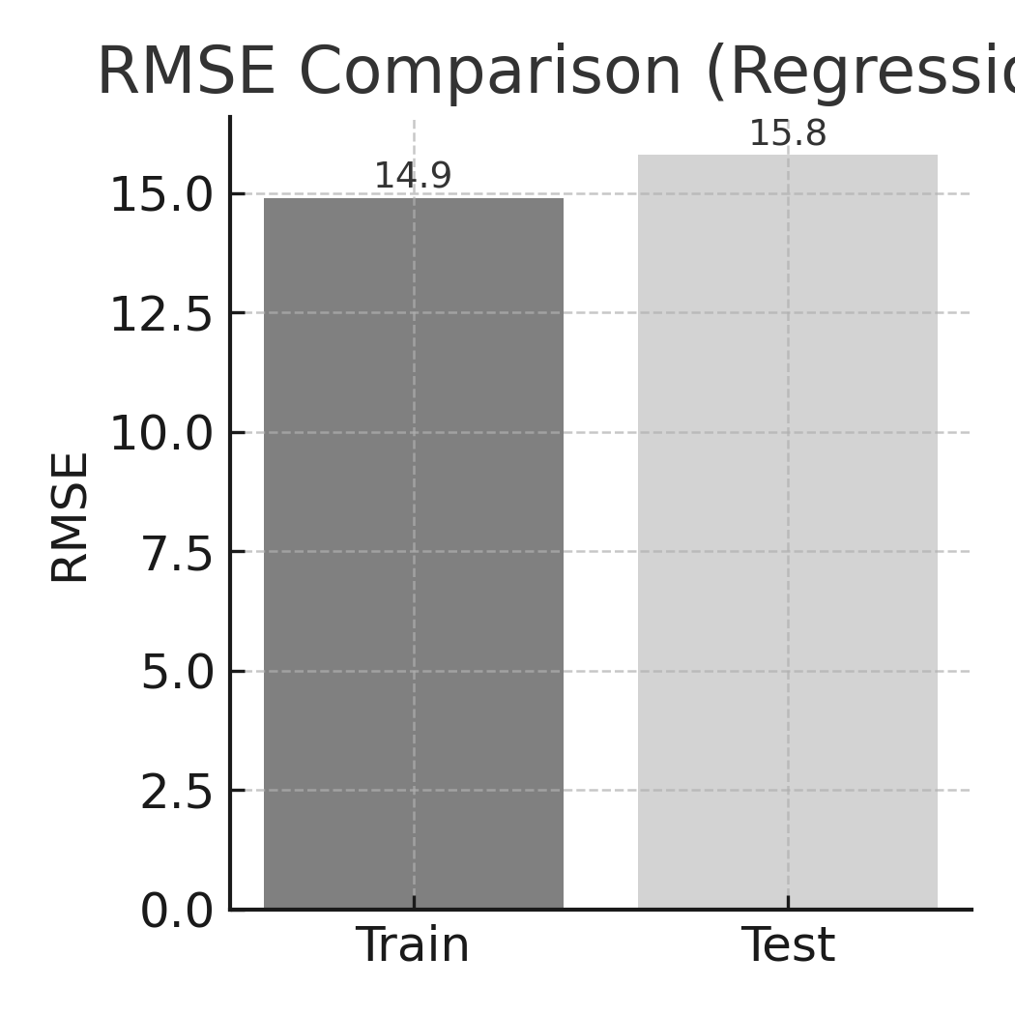
Regression Experiment (C1)
Linear Regression on Synthetic Data
Train RMSE: 14.9 Test RMSE: 15.8
The similar RMSE values suggest good generalization with minimal overfitting. The model effectively captures linear relationships between input features and targets. Visualization of predicted vs. actual values or residuals could further confirm model fit quality.

Slide 5
Classification Experiment (C2)
Logistic Regression on Moon-Shaped Data
Accuracy: 0.87
Decision boundary and confusion matrix plots illustrate how the model separates the two classes. Because Logistic Regression is linear, it cannot fully capture the curved structure of the data, resulting in some misclassifications near overlapping regions. Nonetheless, the model generalizes reasonably well and performs as expected for a linear classifier.

Slide 6
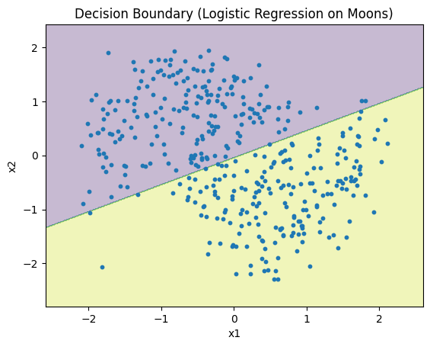
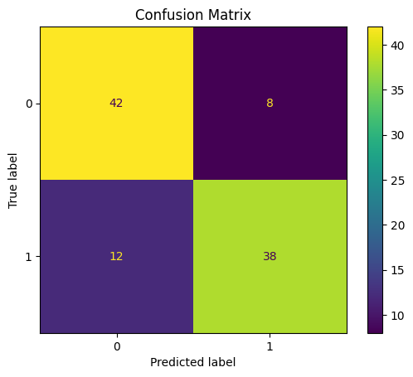
Classification Experiment (C2)

Slide 7
Observations & Lessons Learned
This project reinforced the importance of data preprocessing, feature scaling, and model evaluation. Linear models generalize well on simple relationships but underperform on nonlinear data. K-Fold validation and distance metrics provide quantitative insights into model performance and consistency. Visualization tools such as heatmaps, RMSE charts, decision boundaries, and confusion matrices make results interpretable and intuitive.

Slide 8
Conclusion & Future Work
This project provided practical experience in implementing regression and classification workflows from scratch. Future work could explore nonlinear models such as decision trees or kernel-based methods to handle complex patterns, and apply advanced regularization or ensemble techniques to further improve prediction accuracy and robustness.

